Slide 1

DAYANANDA SAGAR UNIVERSITY
SCHOOL OF ENGINEERING
Department of Computer Science and Technology
Major Project Stage-2
INTELLIGENT VEHICLE SAFETY SYSTEM
Under the Supervision
Prof. Gousia
1
Presented By:
Vasudeva Hegde - ENG20CS0404
Vedant Naik - ENG20CS0405
Vaishnav G B - ENG20CS0397
Prathamesh - ENG20CS0266
Notes:
Title of the project
CSE Dept., SET-Jain University
1

Slide 2
Overview
Abstract
Problem Statement
Introduction
Social/Environmental Impact
State of the Art work
Design
Methodology
Implementation
References
*
Dept of CSE., SOE-Dayananda Sagar University
2 of 12

Slide 3
Abstract
This project introduces an innovative solution centered around sensor-based accident and traffic violation detection.
The project aims to create a robust system that can accurately identify and respond to accidents in real-time.
The system combines GPS technology to continuously monitor vehicle parameters and provide real-time warnings, and emergency response coordination in case of an accident.
The system not only improves road safety but also has societal and environmental benefits, reducing accidents, saving lives, and lowering economic and environmental costs.
*
Dept of CSE., SOE-Dayananda Sagar University
3 of 12

Slide 4
Problem Statement
There is an urgent need to address the persistently high incidence
of road accidents, improve safety measures, and establish
efficient accident prevention and response systems in the face of
increasing traffic hazards, in order to protect lives and enhance
road safety.
Solution
Develop and implement an integrated road safety strategy that combines Sensors and technology to reduce the occurrence of road accidents, enhance safety measures, and ensure a timely and effective response system.
*
4 of 12
Dept of CSE., SOE-Dayananda Sagar University

Slide 5
Introduction
Road accidents and traffic violations are major concerns for public safety. In recent years, there has been a growing interest in using sensors and machine learning to detect and prevent such incidents in real-time.
This project explores the implementation of an accident and detection system using sensors and machine learning algorithms.
This presentation introduces a GPS-based accident prevention system designed to monitor, warn, and respond to potential accidents in real-time.
The system addresses the need for better road safety and contributes to societal and environmental benefits.
*
Dept of CSE., SOE-Dayananda Sagar University
5 of 12

Slide 6
Societal and environmental impacts:
The introduction of an accident prevention system utilizing GPS technology has significant societal and environmental impacts:
Improved Road Safety: This system enhances road safety by continuously monitoring vehicle location, velocity, tilting, and pinch injuries.
Reduced Traffic Accidents: By addressing the issue of accidents on the road, this system contributes to a reduction in the number of traffic accidents.
Lives Saved: The system's ability to automatically inform authorities and emergency services in the event of an accident can lead to faster response times, potentially saving lives and reducing the severity of injuries.
Public Awareness: The use of GPS technology raises awareness about road safety and encourages responsible driving behaviour.
*
6 of 12
Dept of CSE., SOE-Dayananda Sagar University

Slide 7
State of the Art-work
Author’s Name/Project title | Conference/journal name and year | Technology/Design | Results shared by Author | What you infer
Sajal Gupta, Manish Rawat | Accident Detection and Prediction with Notification Alert System. 2022 | The technology and methods involved, the specific computational intelligence techniques, algorithms, | The result would describe the problem of road accidents and introduces the concept of such a system. | The proposal of a technology-driven solution that uses computational intelligence techniques to predict and prevent accidents by analyzing video data from CCTV cameras.
Gopal Sunil Rathod Kapil Jajulwar Umesh Kubde | Machine learning-based intelligent accident detection and notification system in IoT network 2023 | The technologies used in this system include IoT for data collection and transmission, machine learning for data analysis and decision-making, cloud computing for data processing, and various data sensors and communication technologies. | Accident Detection which would determine the Response Time which would result in Reduction in Casualties. | The paper introduces a technology-driven solution to address the problem of traffic accidents and emphasizes the potential for technology to play a crucial role in reducing accidents' impact through early detection and response.

Slide 8
Author’s Name/Project title | Conference/journal name and year | Technology/Design | Results shared by Author | What you infer
Qian Cao; Zhihui Li; Yongjian Ma; Haitao Li | Optimal Layout of Sensors for Traffic Accidents Detection and Prevention. 2022 | Traffic accident risk distribution assessment model. sensors optimal layout model. | The results show that the proposed method could deal with traffic accidents uncertainty efficiently and achieve the optimal layout of heterogeneous sensors on road network | The goal of the described method is to improve traffic safety by optimizing the placement of sensors on a road network. These sensors are intended for detecting and preventing traffic accidents
Nikhil Kumar Debopam Acharya Divya Lohani | An IoT-Based Vehicle Accident Detection and Classification System Using Sensor Fusion. 2022 | IOT Machine Learning Models. | The result of the research paper was to demonstrate the feasibility and effectiveness of the proposed system, with an emphasis on the Naïve Bayes model's high accuracy in accident classification. | The research paper highlights a novel IoT-based approach to accident detection and classification and provides evidence of its effectiveness, particularly in terms of the Naïve Bayes model's high accuracy

Slide 9
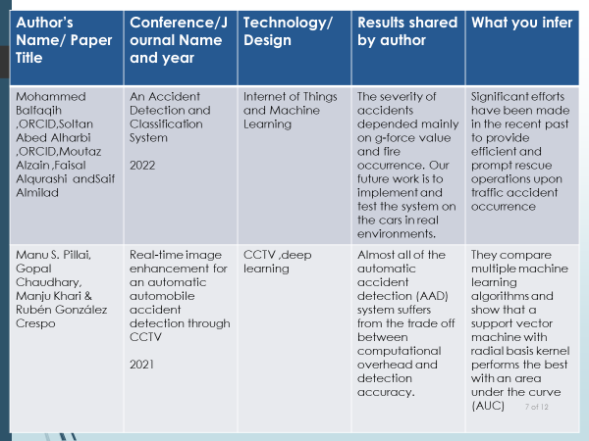
Literature survey
Do not copy paragraphs from papers or your report
Can include a table like below( this is in general: include or exclude columns as per guide instructions)
Author’s Name/ Paper Title | Conference/Journal Name and year | Technology/ Design | Results shared by author | What you infer
*
Dept of CSE., SOE-Dayananda Sagar University
9 of 12

Slide 10
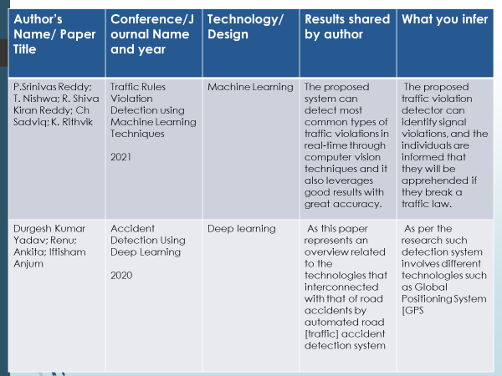

Slide 11
Functional requirements analysis:
GPS Data Acquisition
Vehicle Velocity Monitoring
Tilting Detection
Geographical Coordinates Calculation
Google Maps Integration
Accident Identification
SMS Notification
Warning System
Audio Output and LCD Display
User-Friendly Interface
Cost Efficiency
Reliability
Real-Time Monitoring
Emergency Response Coordination

Slide 12
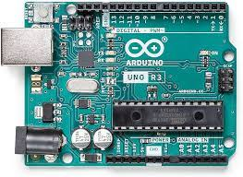
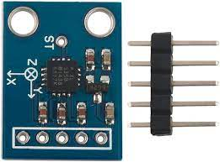
Hardware Requirements
i. Arduino Board
The Arduino board serves as the central microcontroller, providing the necessary computational power and connectivity for the system.
ii. ADXL 335
The ADXL335 is a small, thin, low-power, complete 3-axis accelerometer with signal-conditioned voltage outputs. The product measures acceleration with a minimum full-scale range of ±3 g. It can measure the static acceleration of gravity in tilt-sensing applications, as well as dynamic acceleration resulting from motion, shock, or vibration.

Slide 13
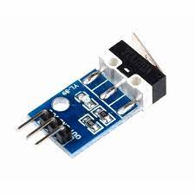
Hardware Requirements
iii. Crash Collision Sensor
The crash sensor detects the collision and converts it to usable signals within milliseconds. The speeding-up forces acting on the sensors after a collision are high.

Slide 14
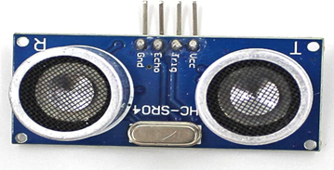
Hardware Requirements
IV. ULTRASONIC SENSOR
The ultrasonic sensor stands as a sophisticated electronic device meticulously crafted to gauge distance or identify the presence of objects through the utilization of ultrasonic waves—sound waves characterized by frequencies surpassing the upper limit of human hearing.

Slide 15
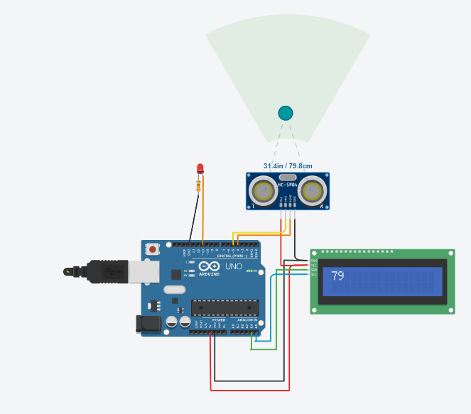
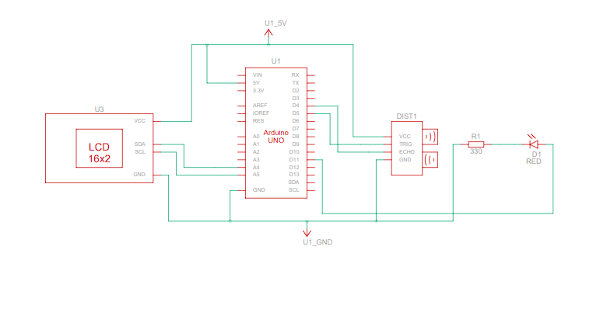
Simulation for ultrasonic sensors

Slide 16
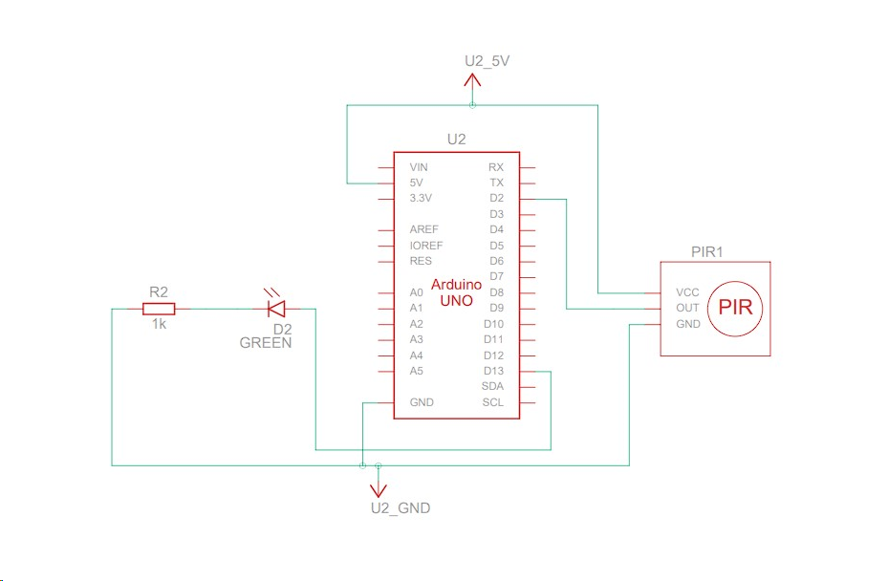
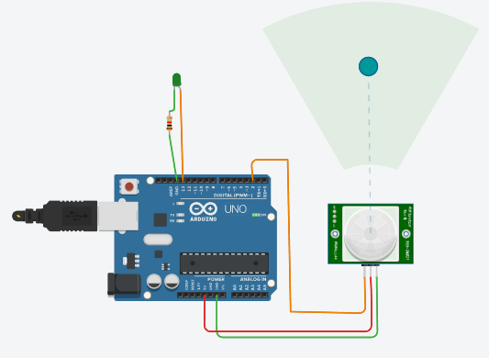
Simulation for Infrared sensor

Slide 17
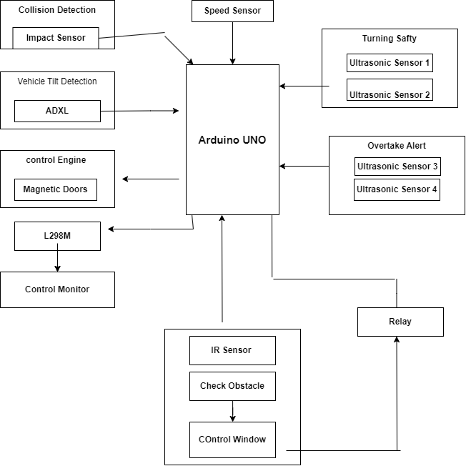
Design
*
Dept of CSE., SOE-Dayananda Sagar University
17 of 12

Slide 18
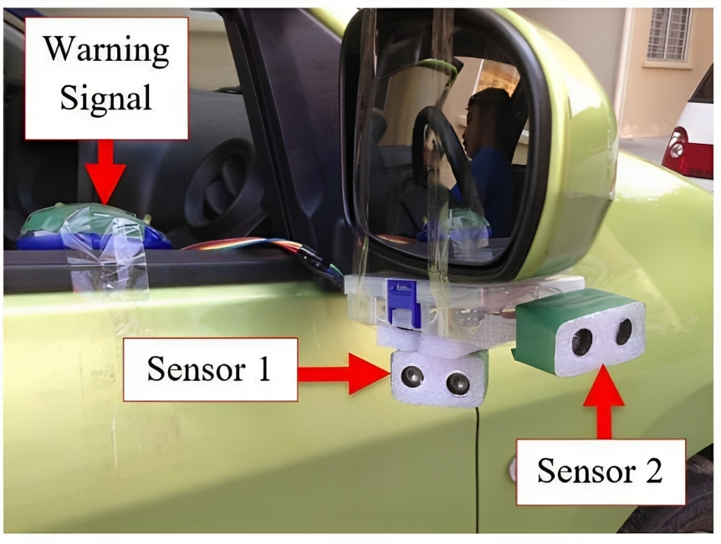
Methodology
Blind spot detection using sensors

Slide 19
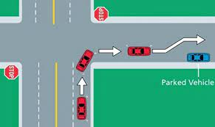
Methodology
Smart Assist

Slide 20
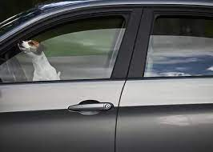
Methodology
Accidents caused during closing of window
(Pinching injuries)

Slide 21
Methodology
Accident Detection and Alarming System:
Data collection and processing
Convolutional Neural Network (CNN) model design
Image processing technology
Using the alarm
Evaluation of Performance
Optimizations

Slide 22
PUBLICATION
A Research paper on “INTELLIGENT VEHICLE SAFETY SYSTEM ” , which is published to the IEEE Conference will be shared.
*
22 of 12
Dept of CSE., SOE-Dayananda Sagar University

Slide 23
References
Reddy, P.S., Nishwa, T., Reddy, R.S.K., Sadviq, C. and Rithvik, K., 2022, July. Traffic rules violation detection using machine learning techniques. In 2021 6th International conference on communication and electronics systems (ICCES) (pp. 1264-1268). IEEE.
D. K. Yadav, Renu, Ankita and I. Anjum, "Accident Detection Using Deep Learning," 2020 2nd International Conference on Advances in Computing, Communication Control and Networking (ICACCCN), Greater Noida, India, 2020, pp. 232-235, doi: 10.1109/ICACCCN51052.2020.9362808.
Balfaqih, M., Alharbi, S.A., Alzain, M., Alqurashi, F. and Almilad, S., 2021. An accident detection and classification system using internet of things and machine learning towards smart city. Sustainability, 14(1), p.210.
Pillai, M.S., Chaudhary, G., Khari, M. and Crespo, R.G., 2021. Real-time image enhancement for an automatic automobile accident detection through CCTV using deep learning. Soft Computing, pp.1-12.
Kumar, Nikhil, Debopam Acharya, and Divya Lohani. "An IoT-based vehicle accident detection and classification system using sensor fusion." IEEE Internet of Things Journal 8.2 (2020): 869-880.
Dept of CSE., SOE-Dayananda Sagar University
23 of 12

Slide 24
Alvi, Unaiza, et al. "A comprehensive study on IoT based accident detection systems for smart vehicles." IEEE Access 8 (2020): 122480-122497.
Rahman, Md Atiqur, et al. "Iot based smart helmet and accident identification system." 2020 IEEE Region 10 Symposium (TENSYMP). IEEE, 2020.
Kashevnik, Alexey, et al. "Cloud-based driver monitoring system using a smartphone." IEEE Sensors Journal 20.12 (2020): 6701-6715.

